Slide 1

Help.com: Revolutionizing Community Engagement
Welcome to Help.com, a web-based platform designed to simplify donations, promote volunteerism, and foster community engagement. Our team of three is excited to present our innovative solution.
Presented By
k200444 Anil Kumar
k214526 Awesh Kumar
k213959 Danish Nanijiani

Slide 2

The Problem We're Solving
Fragmented Platforms
Limited Scope
Current donation and volunteer systems are scattered and inefficient.
Existing platforms often focus on single aspects of community engagement.
Inefficient Matching
Difficulty in connecting donors with those in need effectively.

Slide 3




Our Solution: Help.com
1
Centralized Platform
2
Seamless Process
3
Efficient Matching
4
Encouraging Volunteerism
Help.com integrates modern web technologies to enhance user experience and community engagement.

Slide 4




Key Features
Easy Donations
Simplify the process of contributing items like clothes and books.
Volunteer Opportunities
Streamlined signup for various community service activities.
Help Requests
Efficient system for those in need to request assistance.

Slide 5
Technology Stack
Frontend
Backend
Database
Deployment
React.js for a responsive and interactive user interface.
Node.js and Express for robust server-side operations.
MongoDB for flexible and scalable data storage.
Heroku or Vercel for reliable and efficient hosting.

Slide 6

Impact and Benefits
Community Building
Resource Optimization
Fostering stronger, more connected local communities through active engagement.
Efficient allocation of donations and volunteer efforts where they're most needed.
Environmental Impact
Social Awareness
Promoting reuse and recycling through streamlined donation processes.
Increasing visibility of local needs and opportunities to help.

Slide 7
User Journey
1
Volunteers
Create an account on Help.com.
2
Donation and Volunteers
Set preferences for donations or volunteering.
3
Donation logistiscs
Explore available donation or volunteer options.
4
Donate Item
Donate items or sign up for volunteer work.

Slide 8
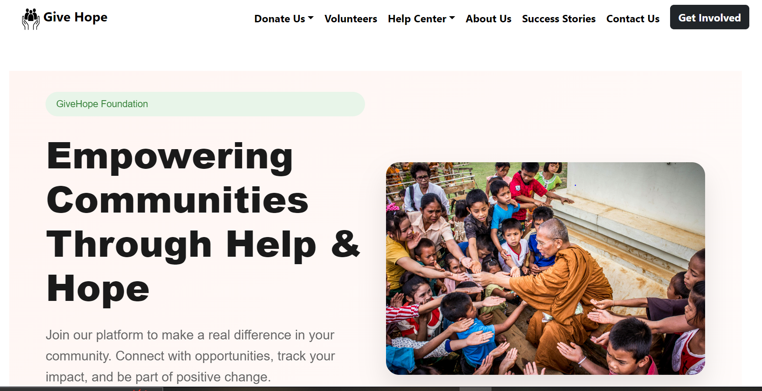
Our Fronted

Slide 9
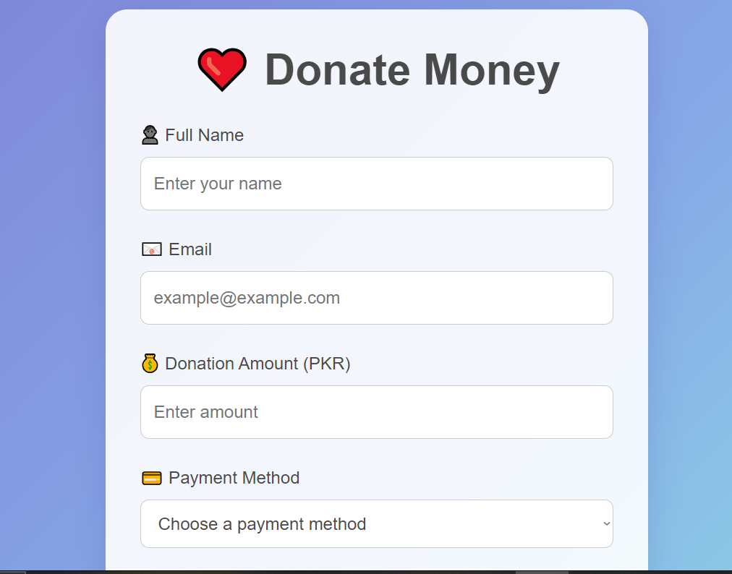

Slide 10
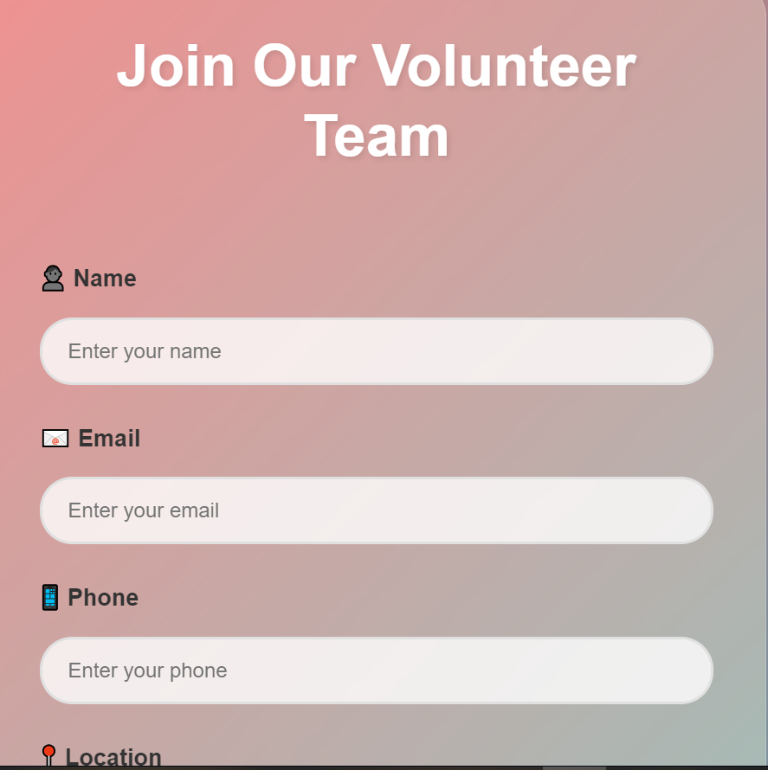

Slide 11
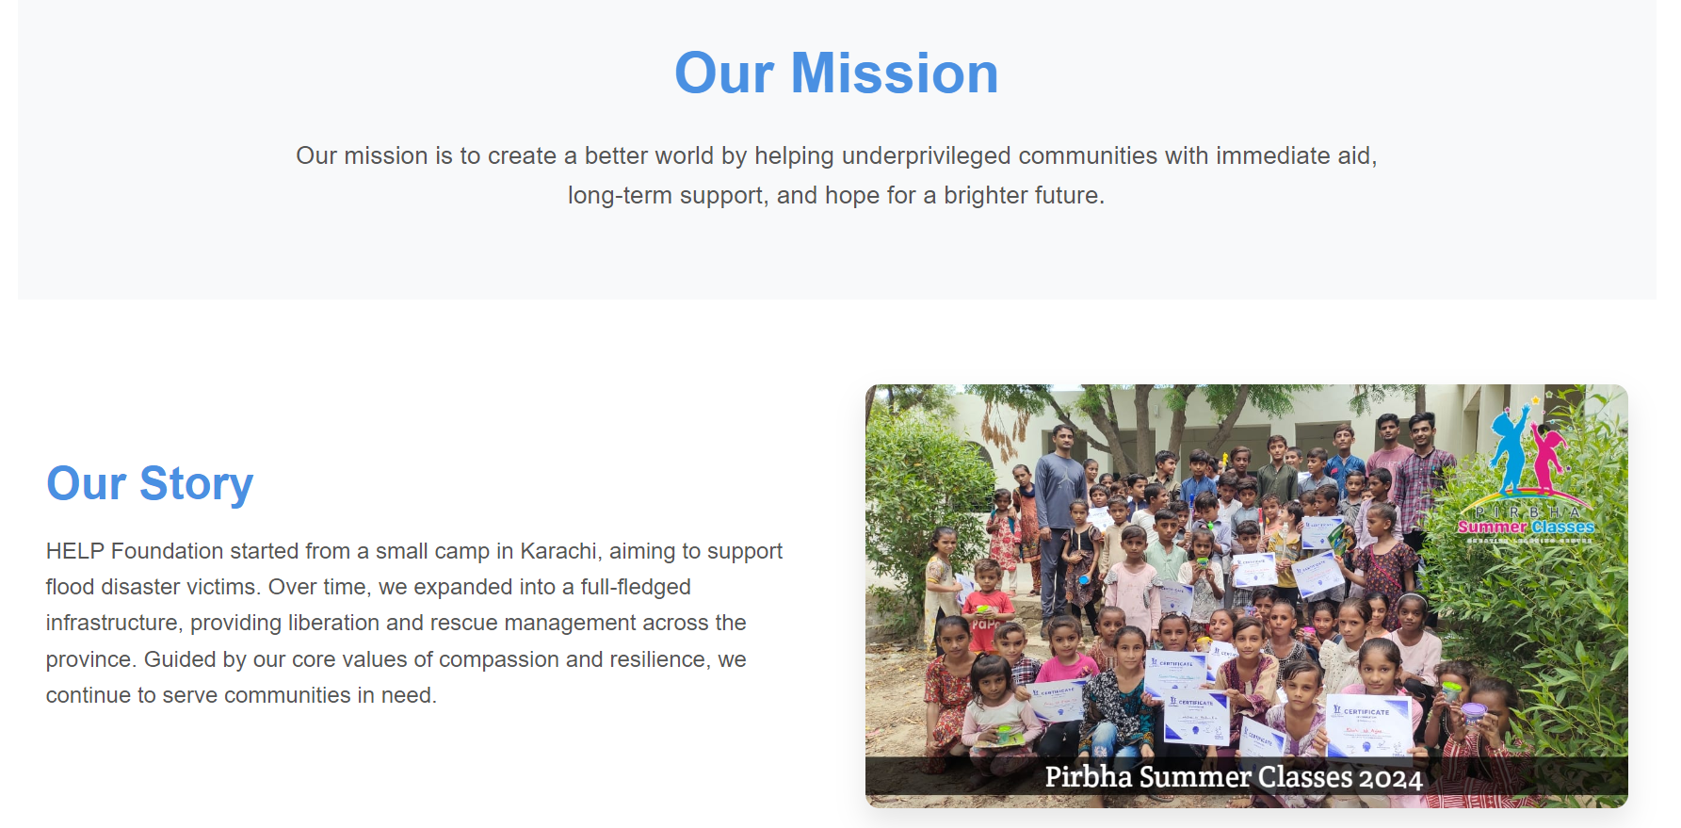

Slide 12
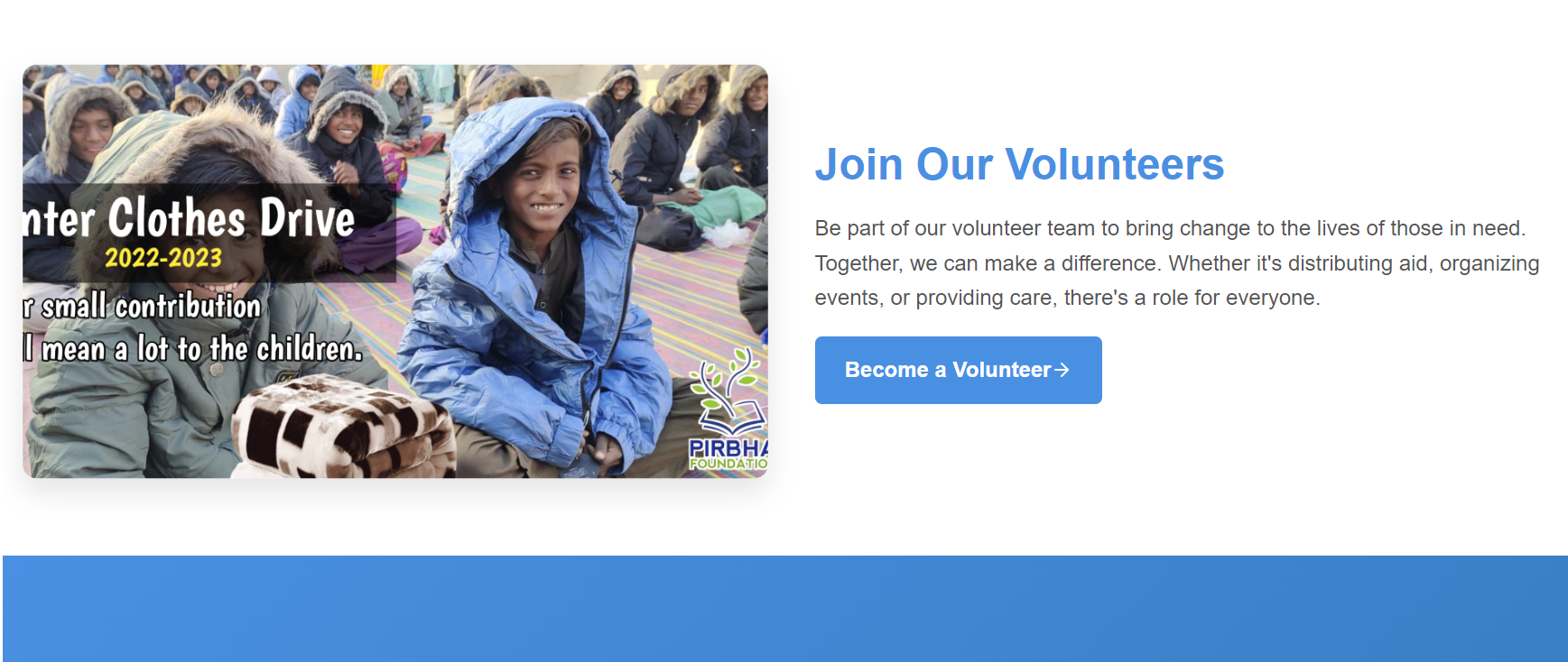

Slide 13
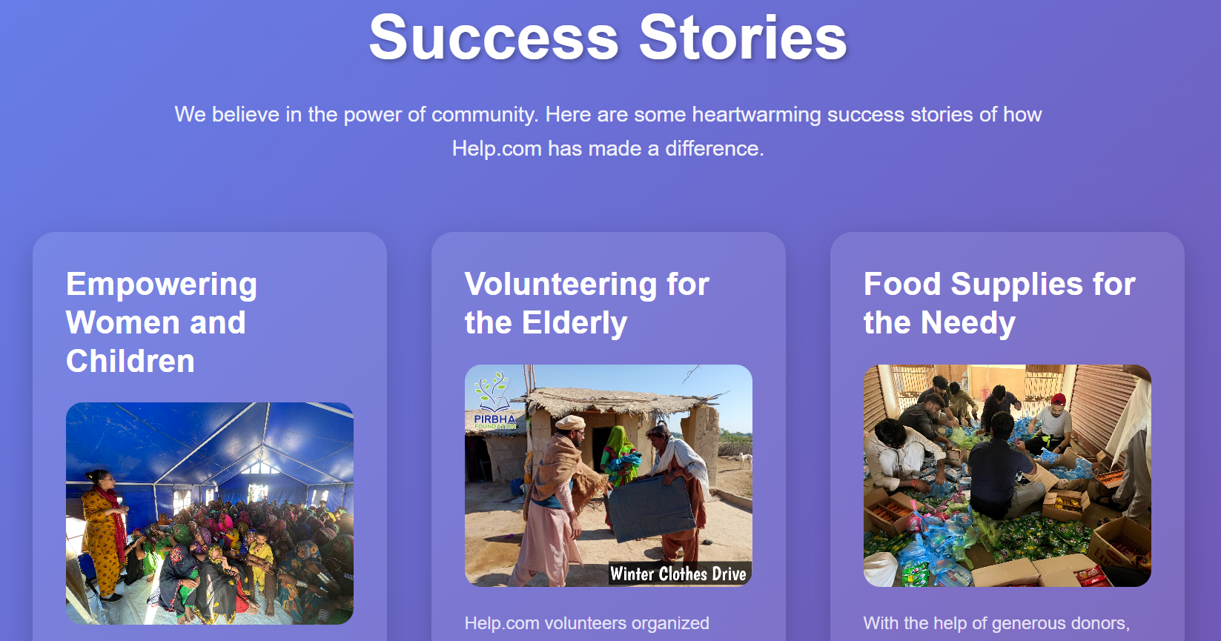

Slide 14
Thank YOU

